Slide 1


Slide 2


Slide 3
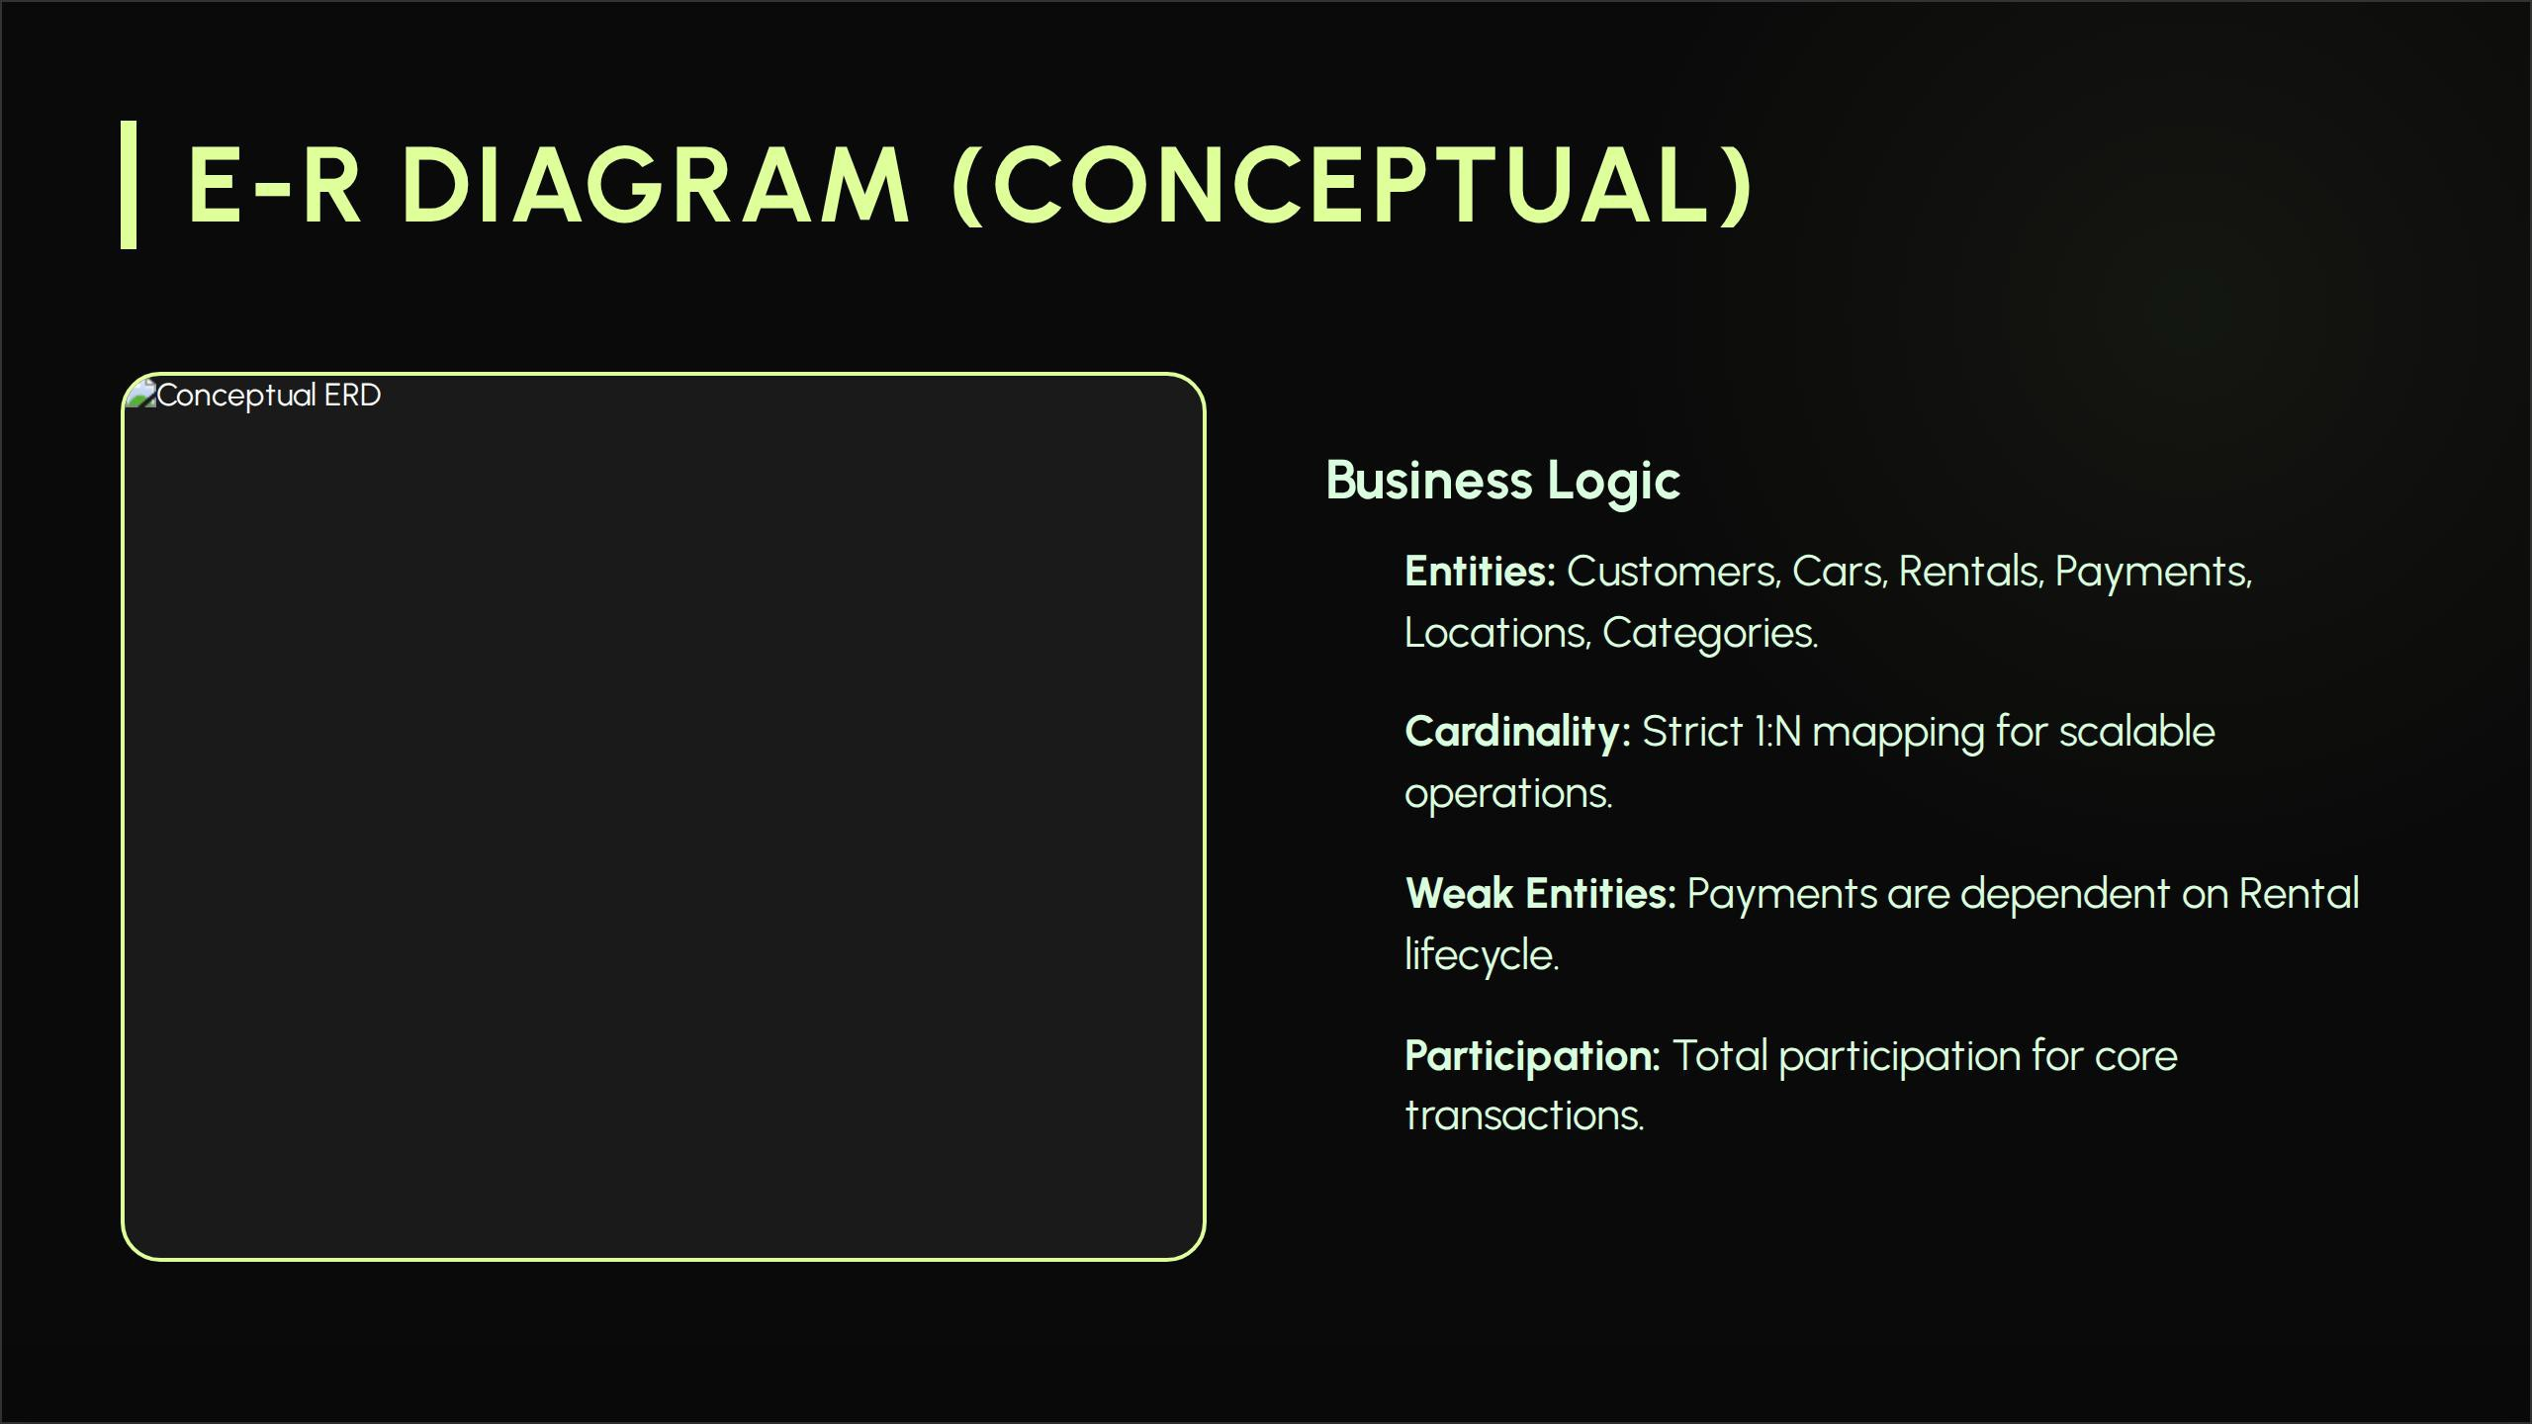
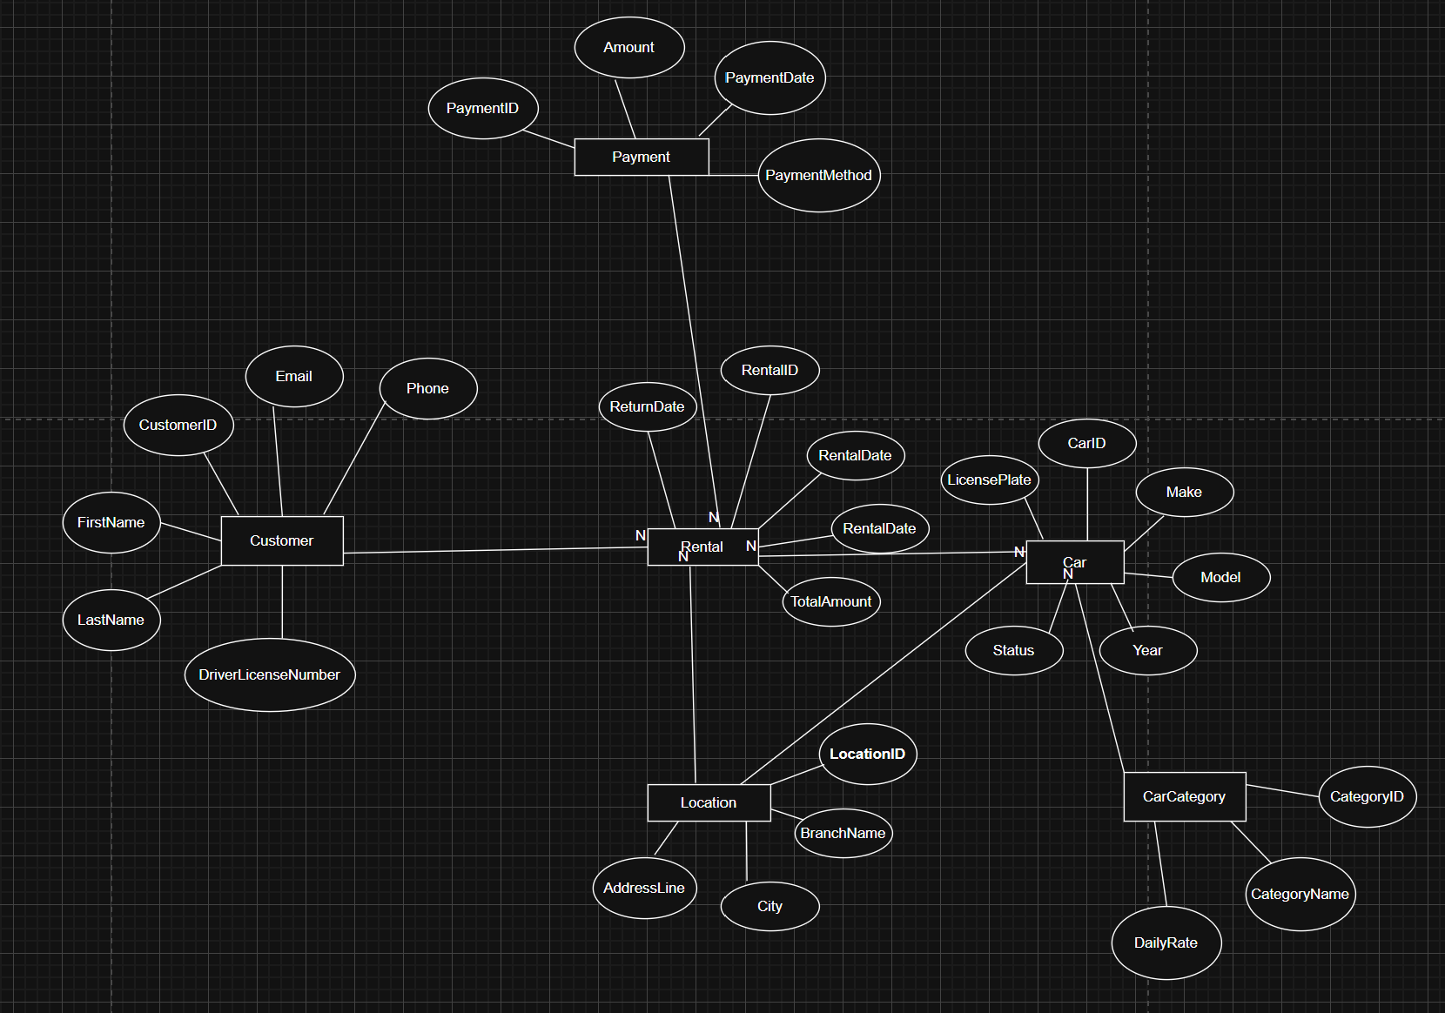

Slide 4
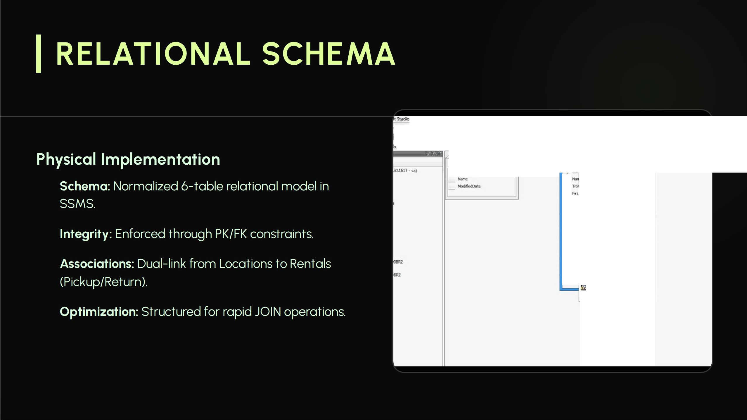
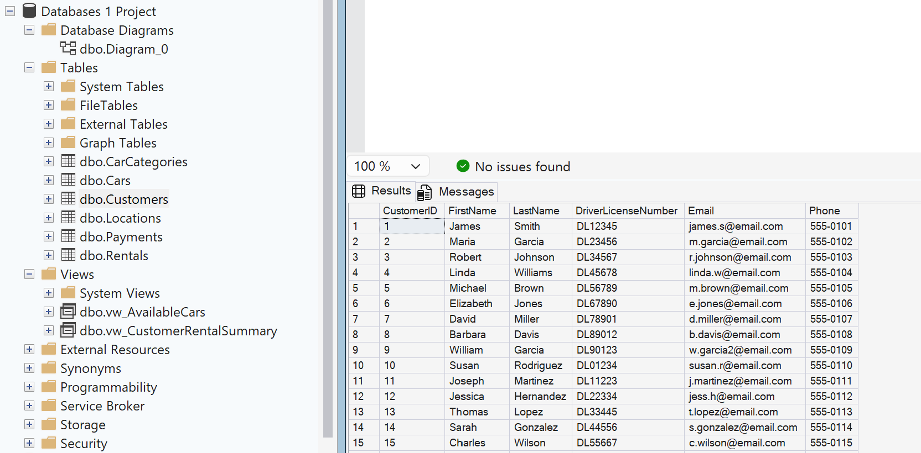
•
g Table Designer Database Oiagcram Took Window Community Help
l:ll123 e:t1Qs
ITableView• 1,₈ I I
12:g Q:8 100%
'WINOOWS7::-Pc.Adv-rks • Diitgr mJ>"L _
C
'1/
-
-
La
o-,s
P
-
Mo

Slide 5
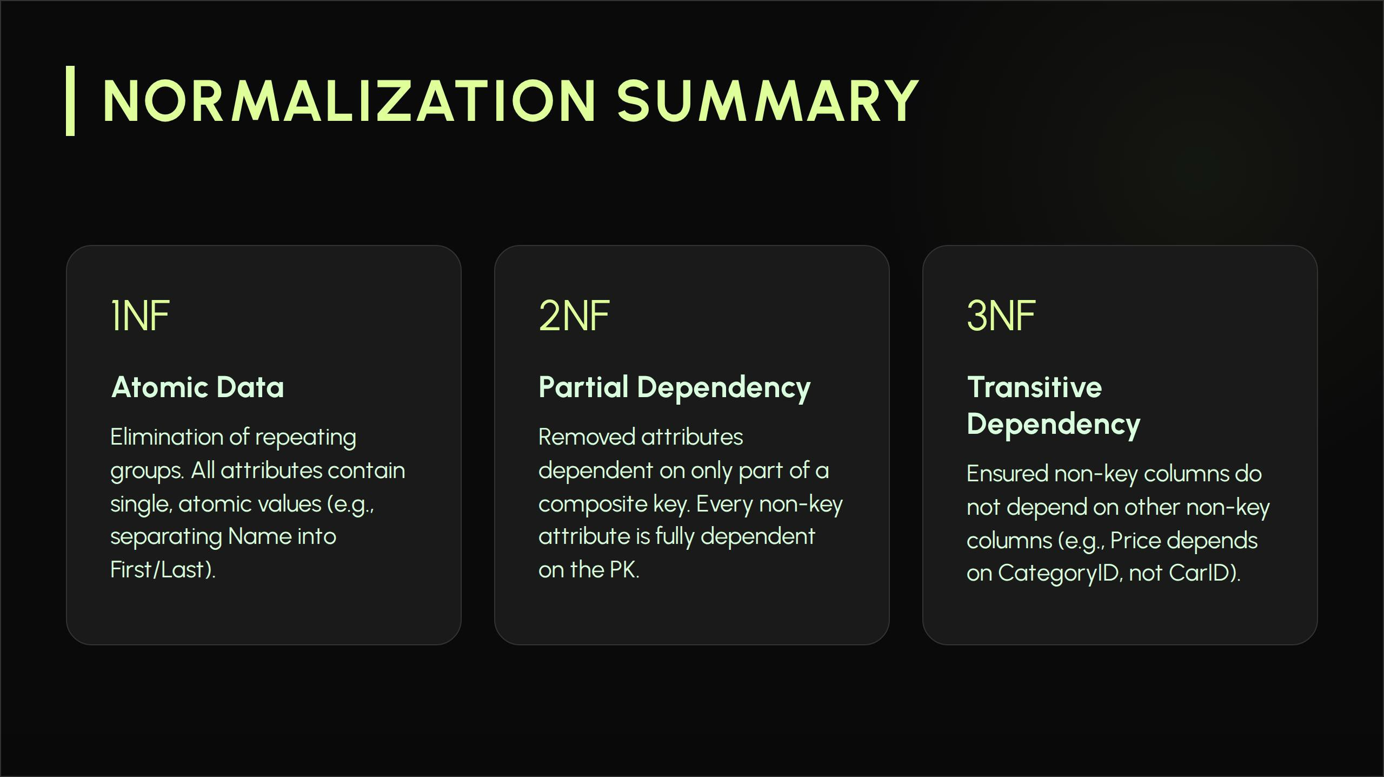

Slide 6

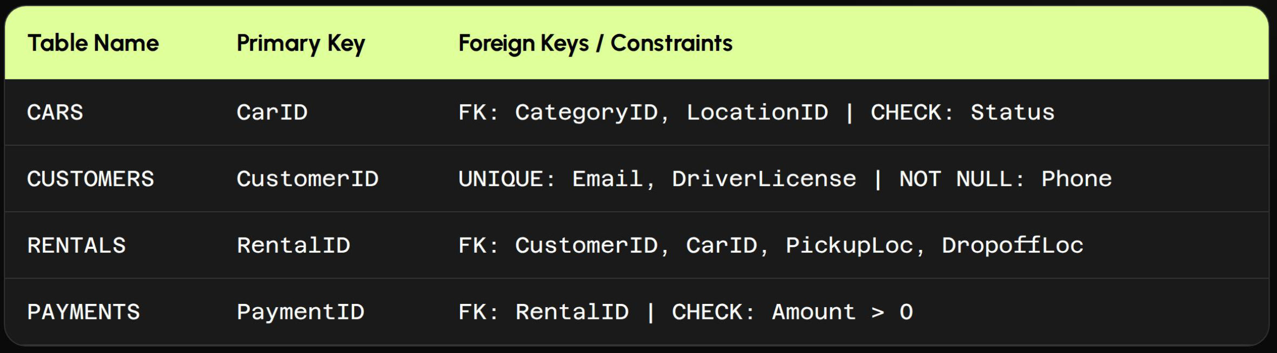

Slide 7
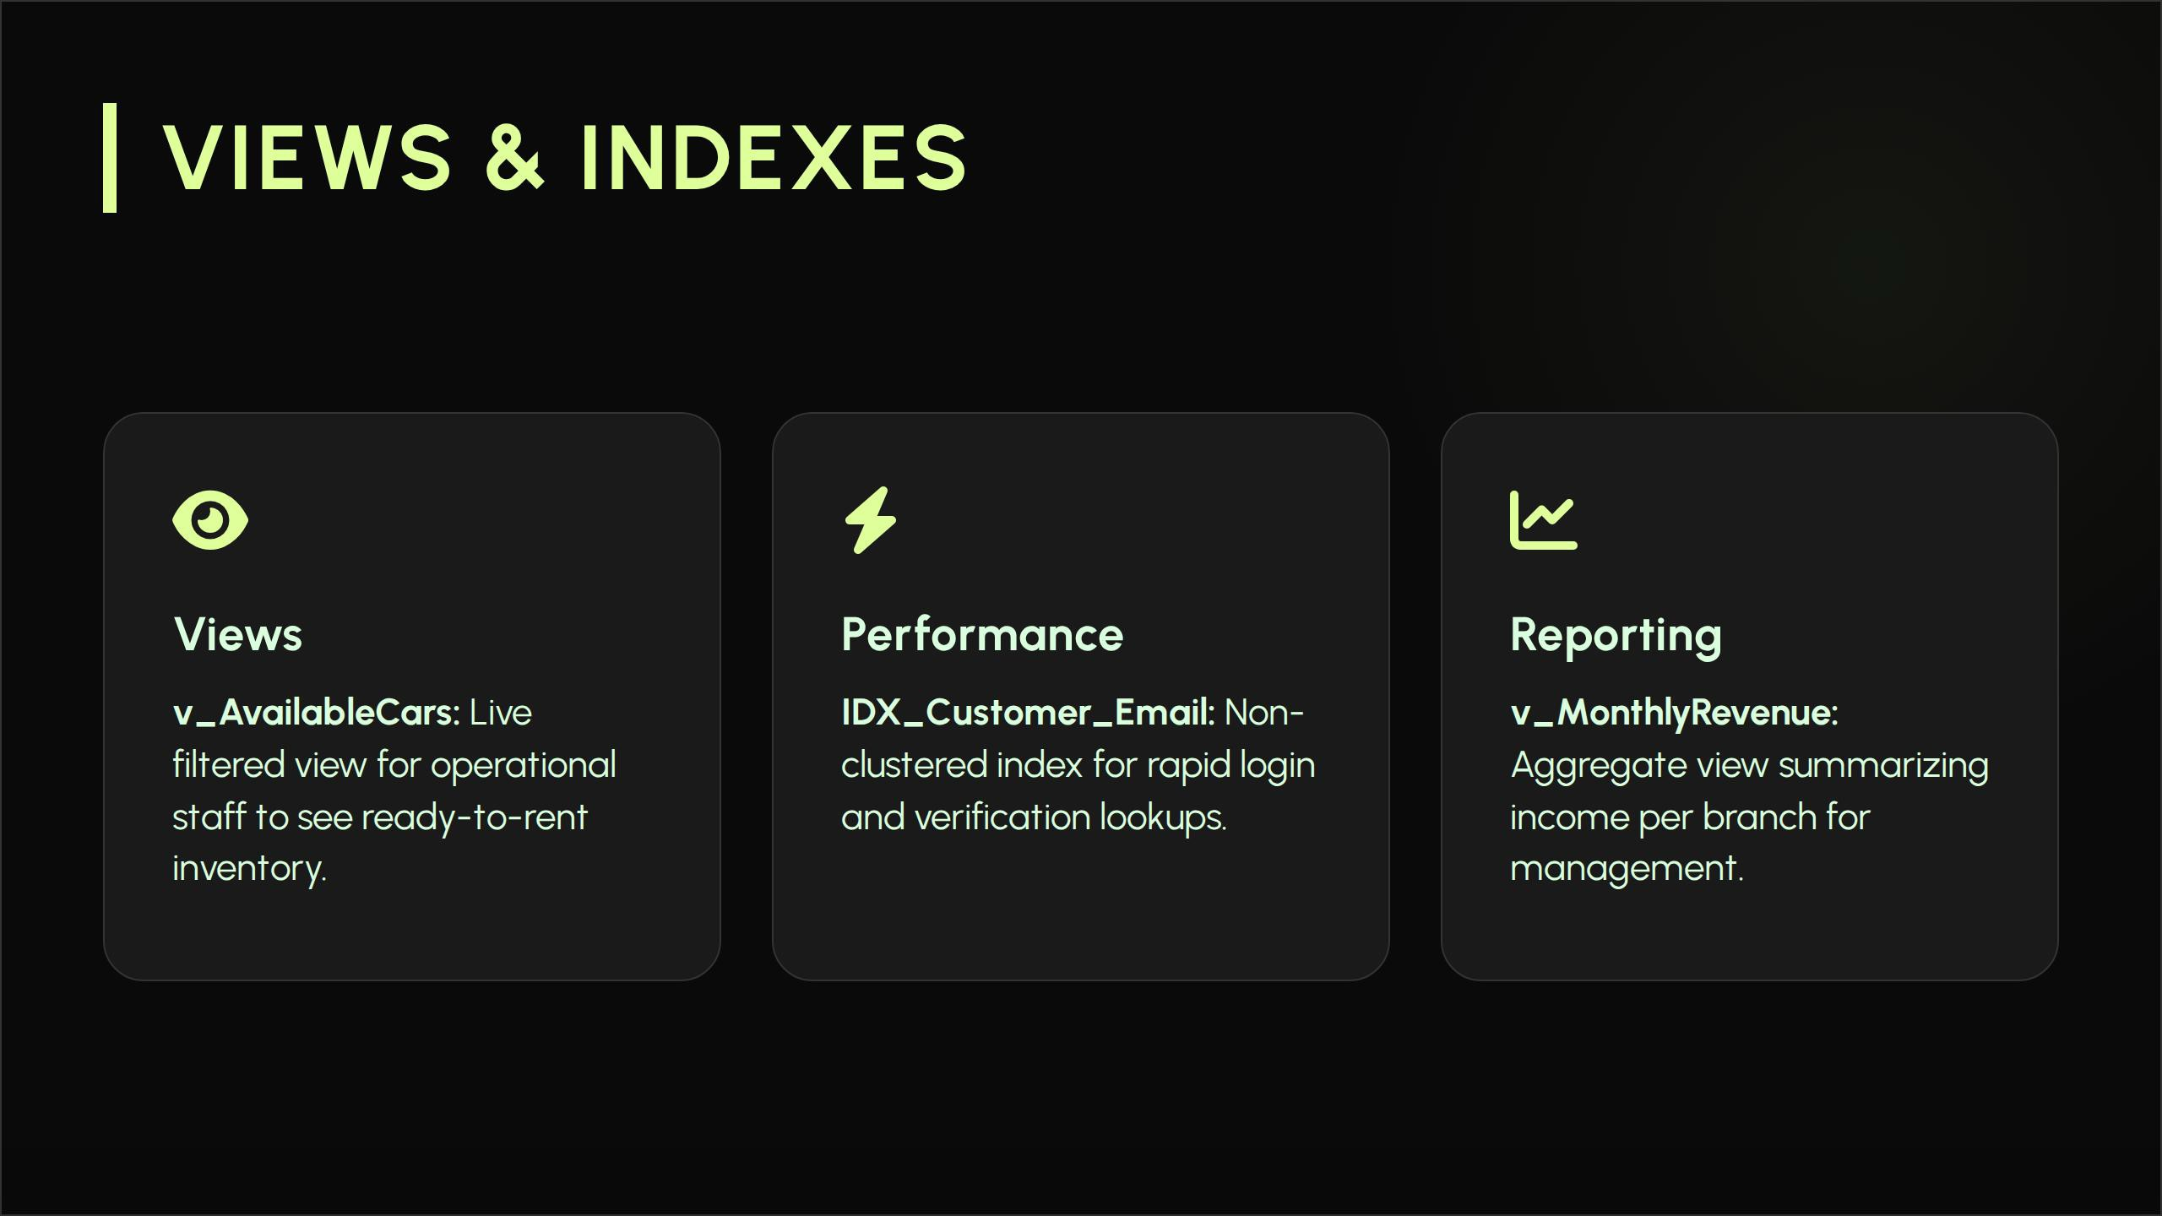

Slide 8
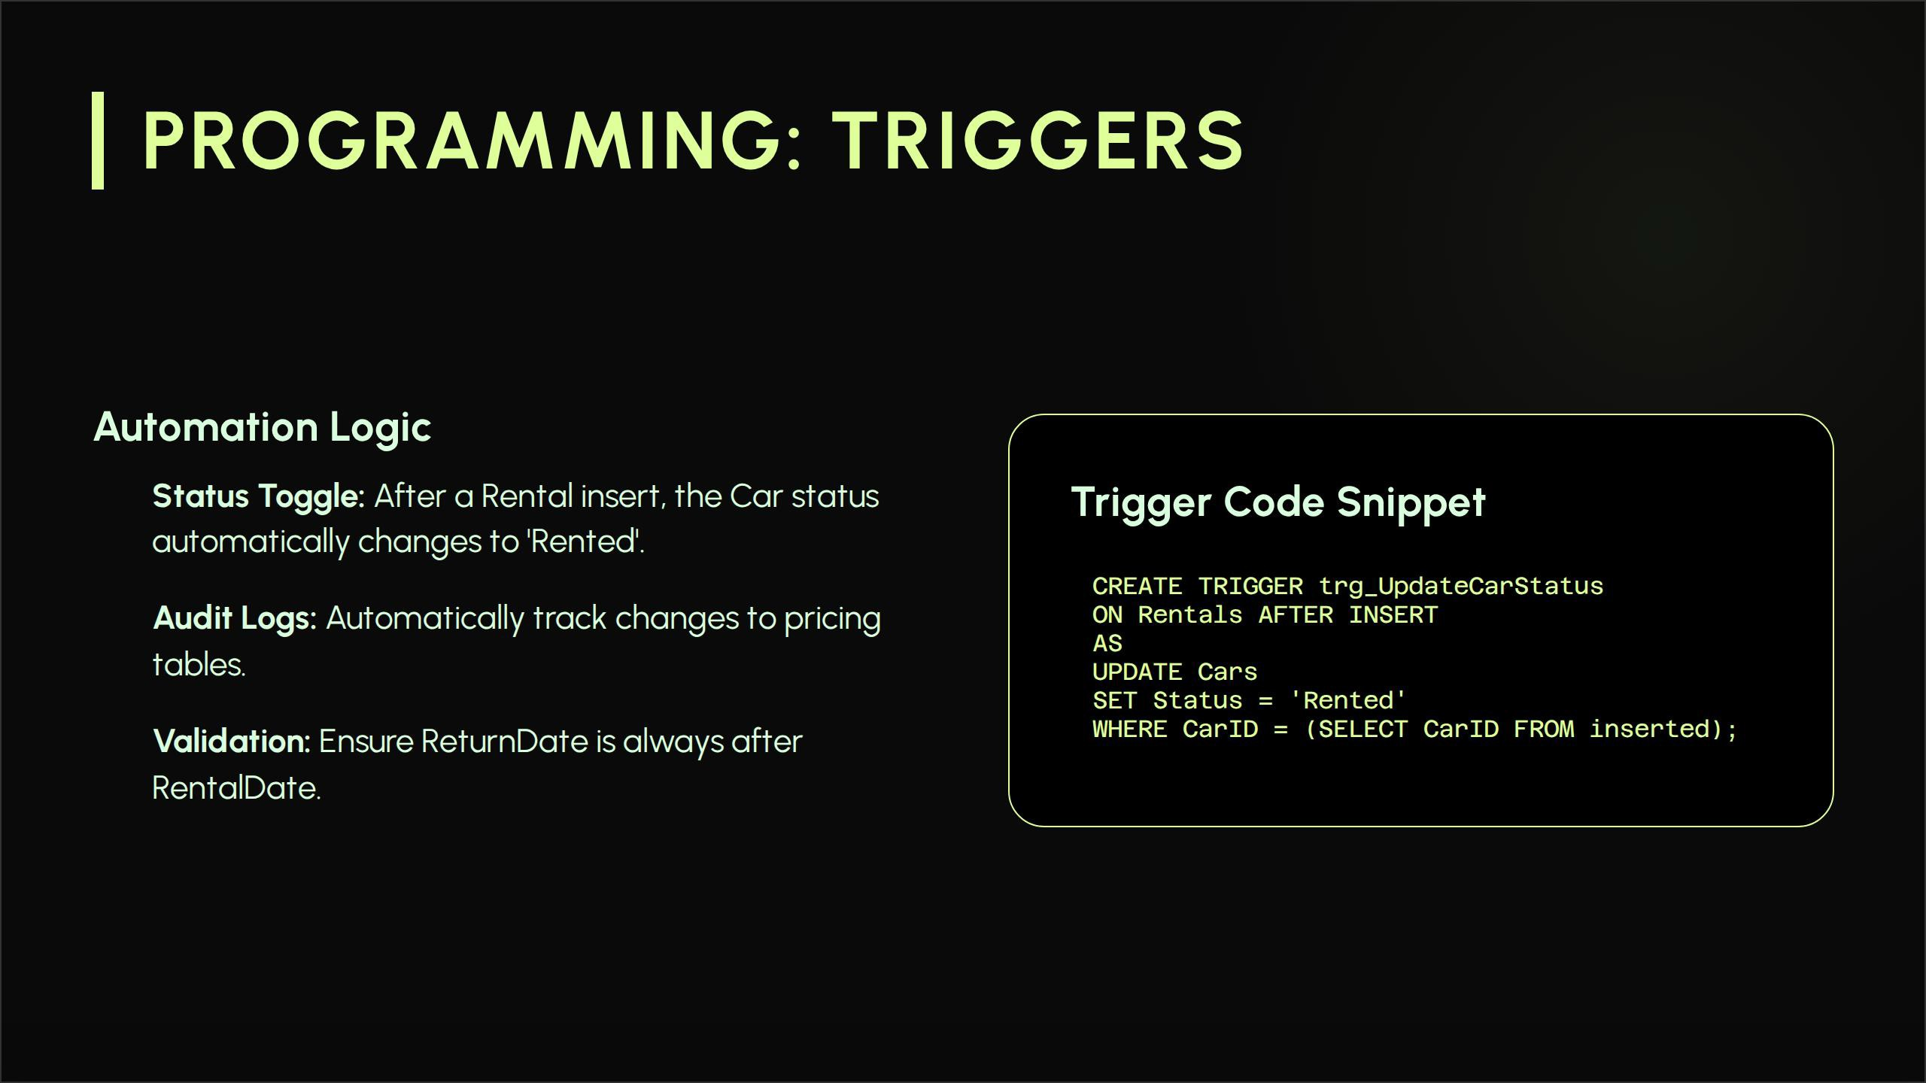

Slide 9

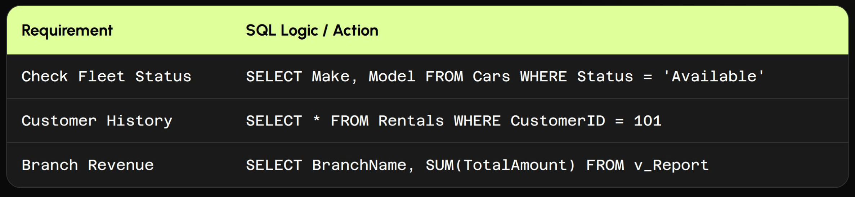

Slide 10
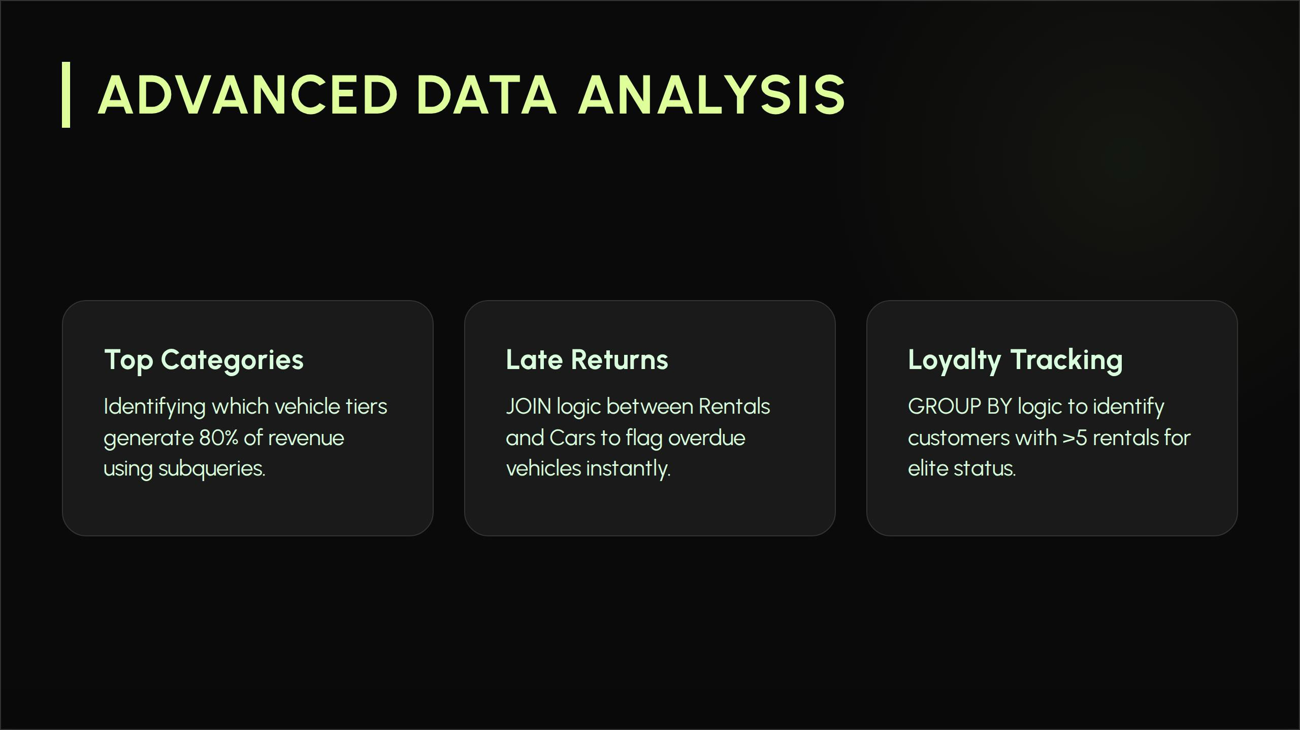

Slide 11


Slide 12


